Slide 1





”I can’t believe it’s not better” Building the LabVIEW IDE and Tools you always wanted
Chris Roebuck

Slide 2



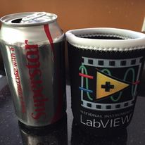


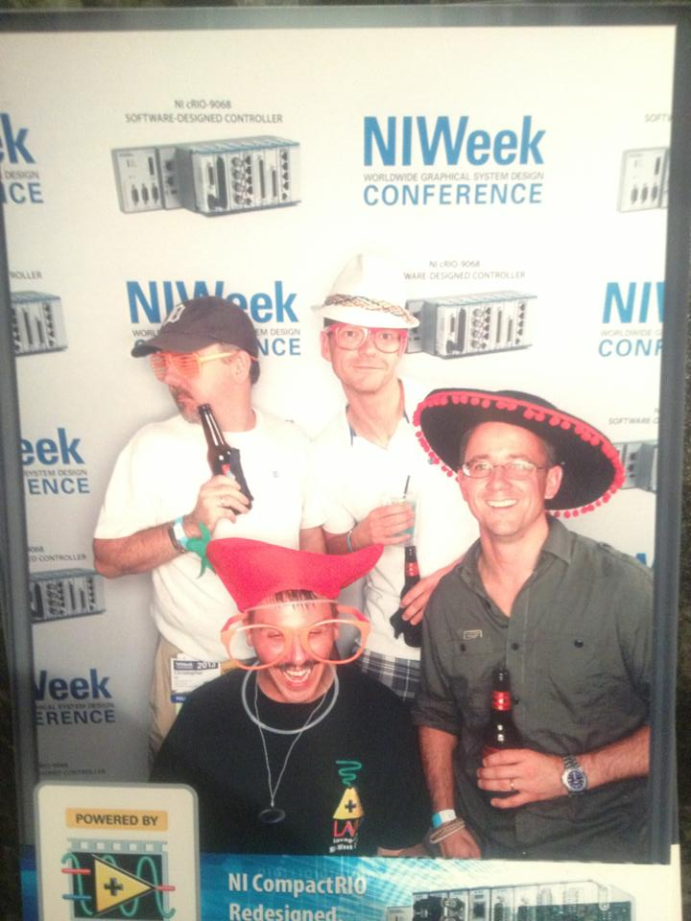


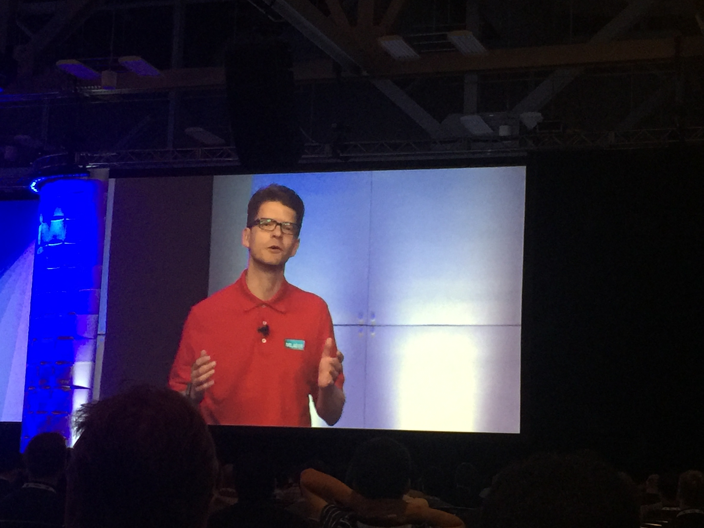
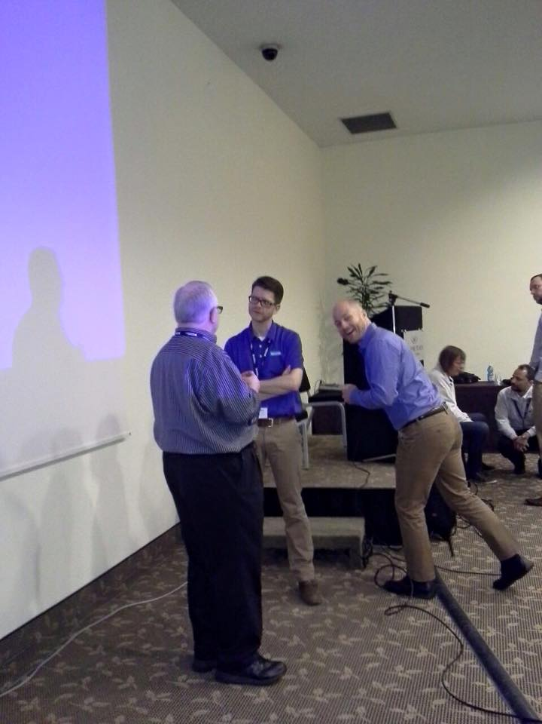
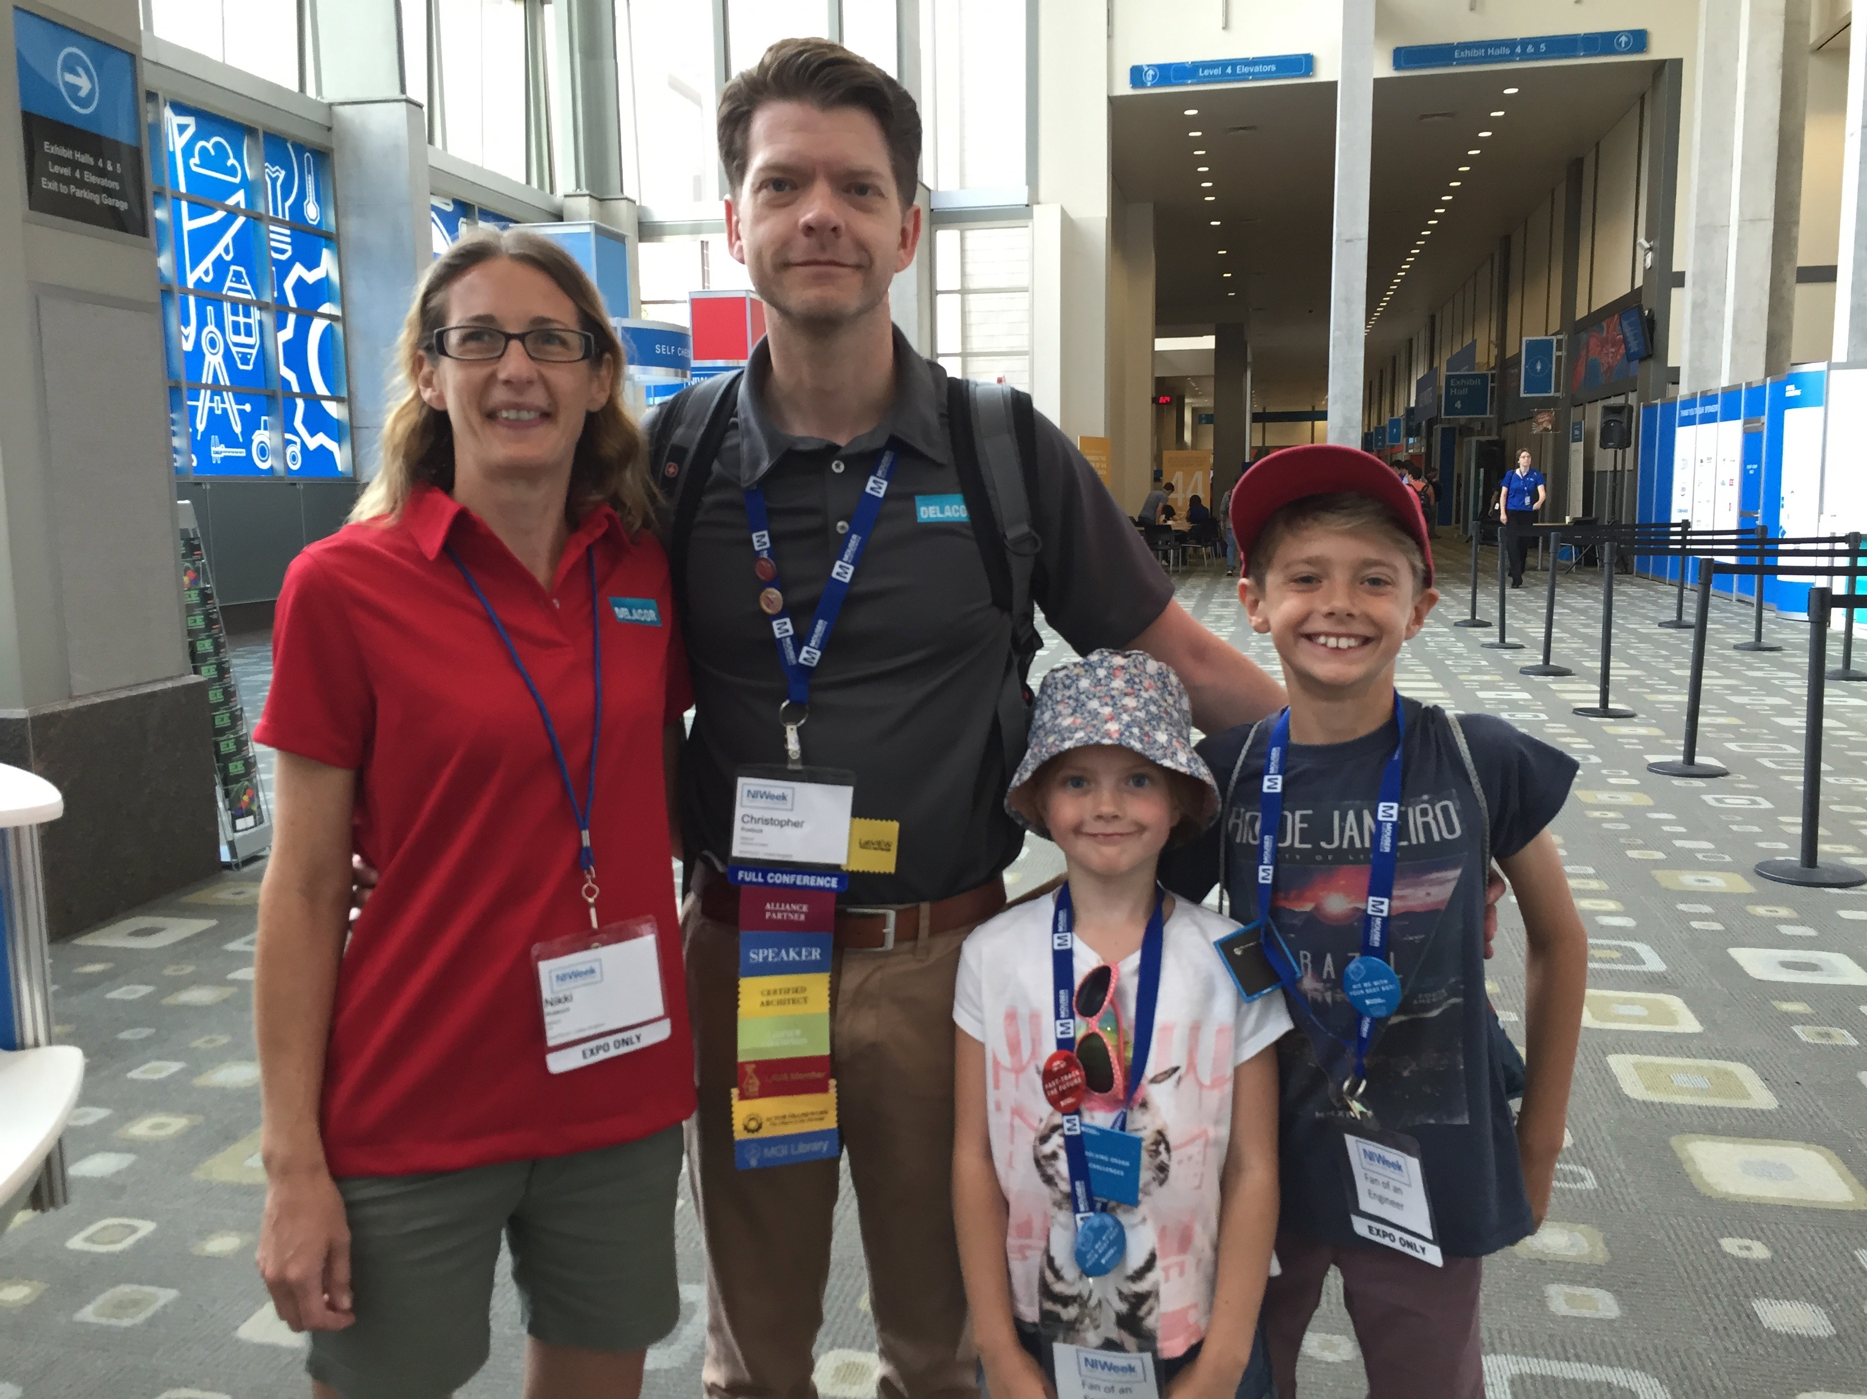
Chris Roebuck
Chief Technology Officer
Physicist
LabVIEW / TestStand evangelist

Slide 3



Chief Technology Officer
Founder
Member of the board

Slide 4




Coming very soon

Slide 5
This presentation and ALL the example code is here:
https://bit.ly/462YWjM

Slide 6
Where to start?

Slide 7
Identify the opportunity
Automate Repetitive Tasks
Make Common Tasks Easier
Reduce Pain Points
Add Missing Features

Slide 8
You’ve got a job to do
Define the problem
Implement the solution
Utilise the hooks

Slide 9

Merge VIs

Slide 10
Merge VI (Shell VI)
Pros
Places the contents of a Sub VI on a block diagram rather than the Sub VI itself
Useful for small / medium size template code or design patterns such as a simple state machine
Facilitates reuse of proven code increasing overall quality / reducing development time
Cons
Requires ‘editing the palette set’ , a little used LabVIEW dialog
(Easier with VIPM)

Slide 11
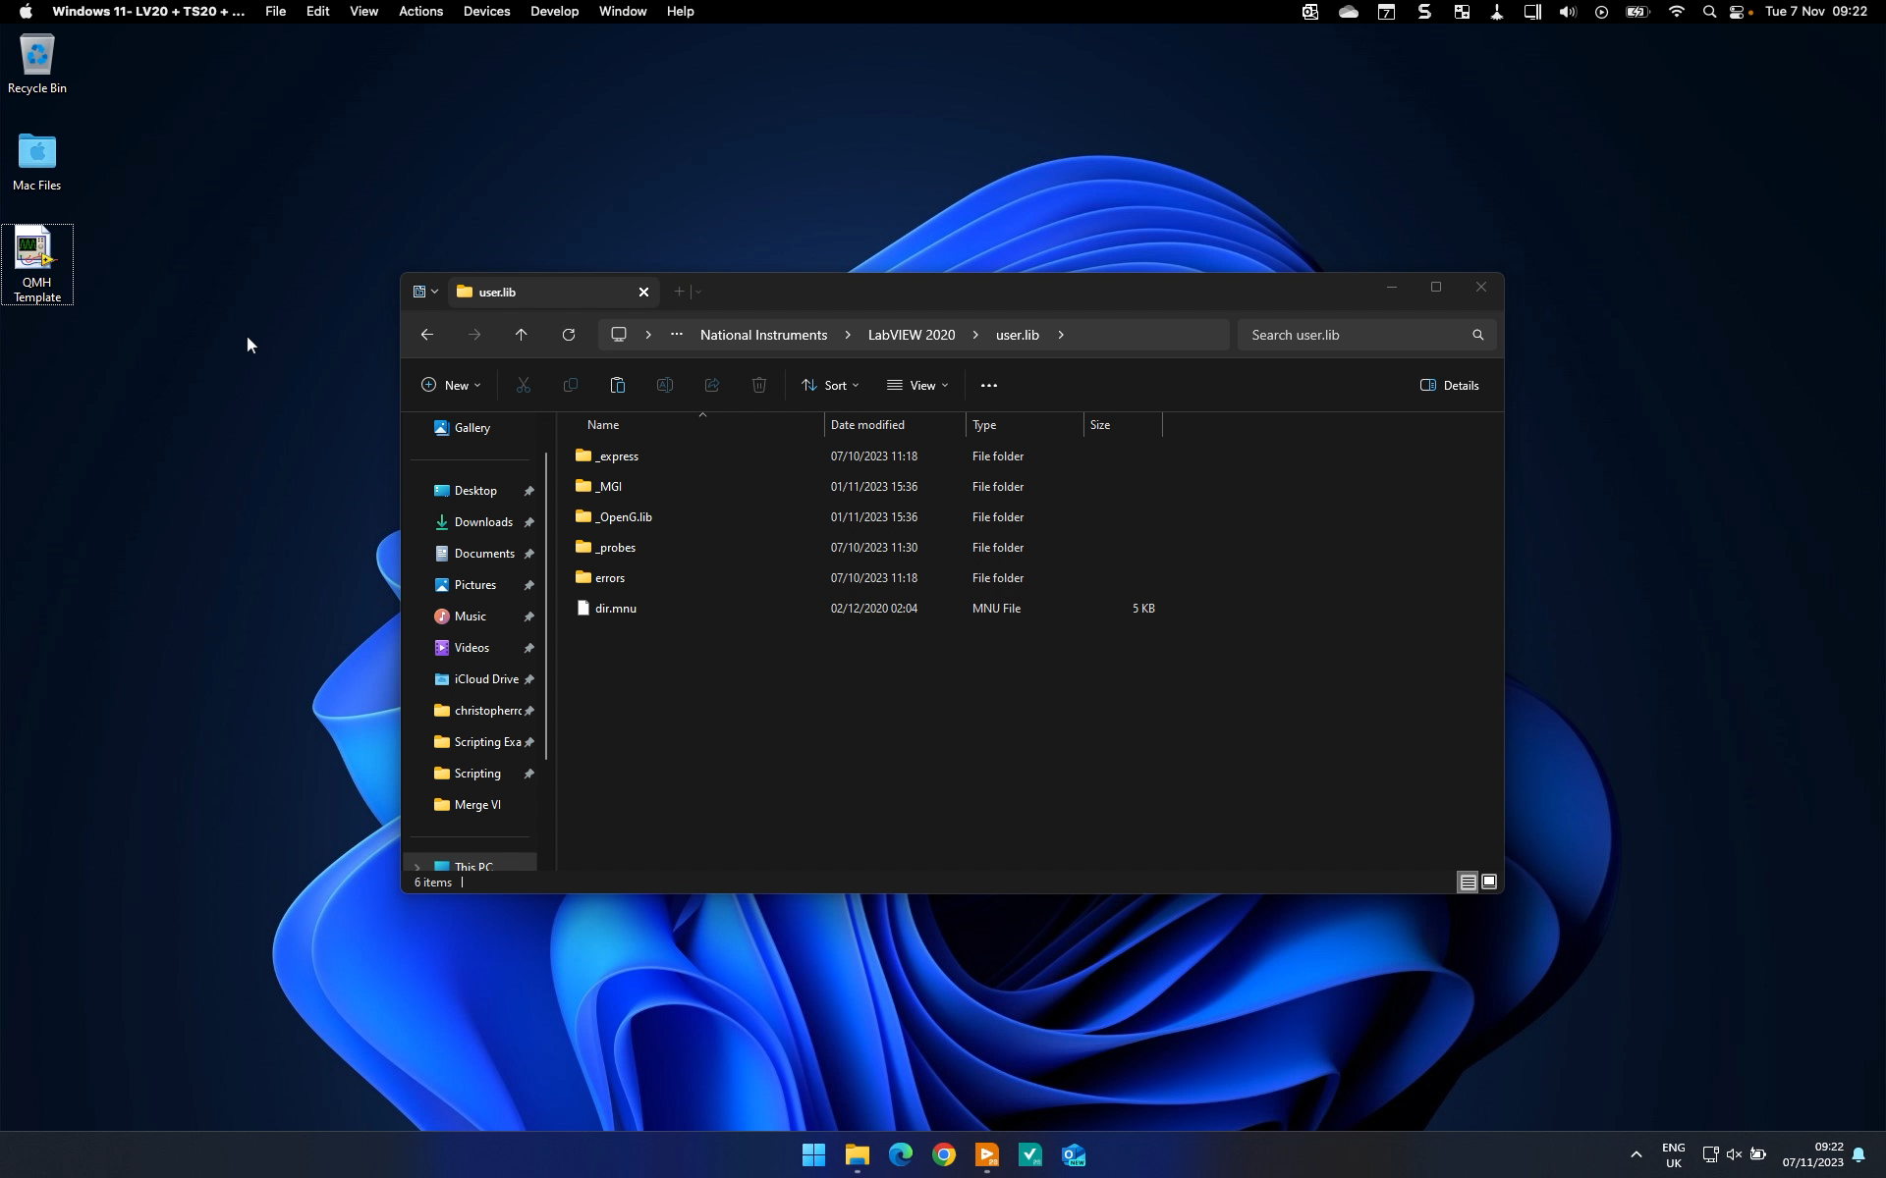

Slide 12
VI Scripting

Slide 13
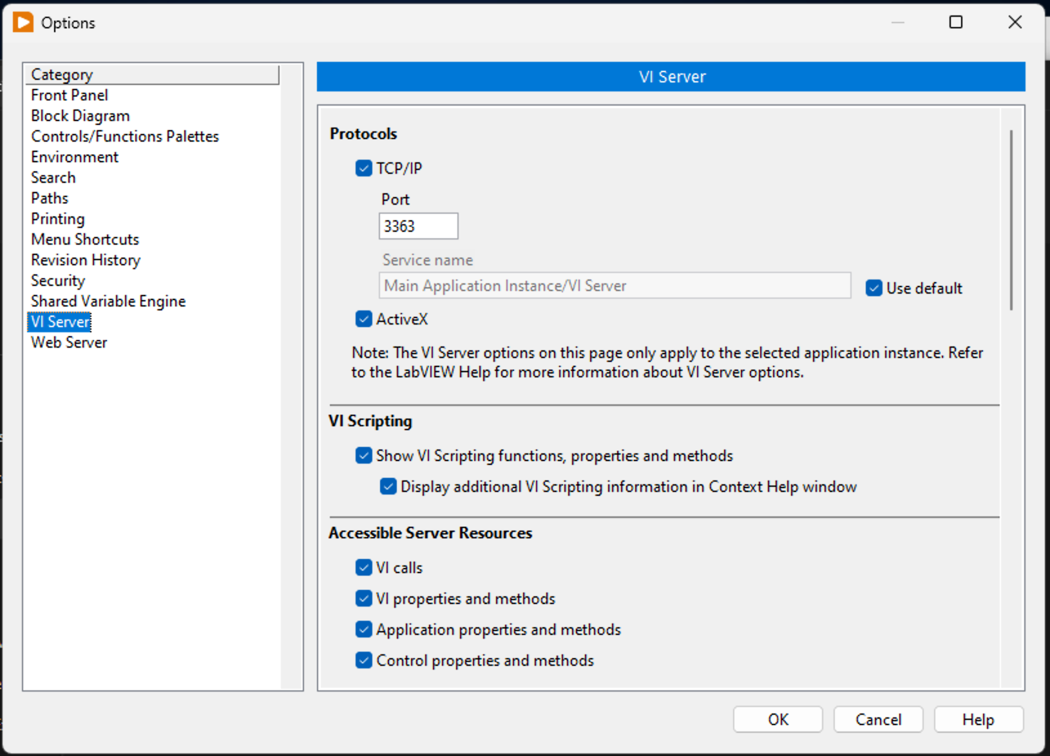
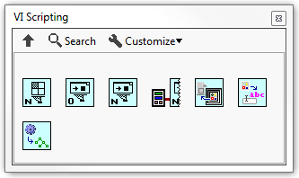
VI Scripting

Slide 14
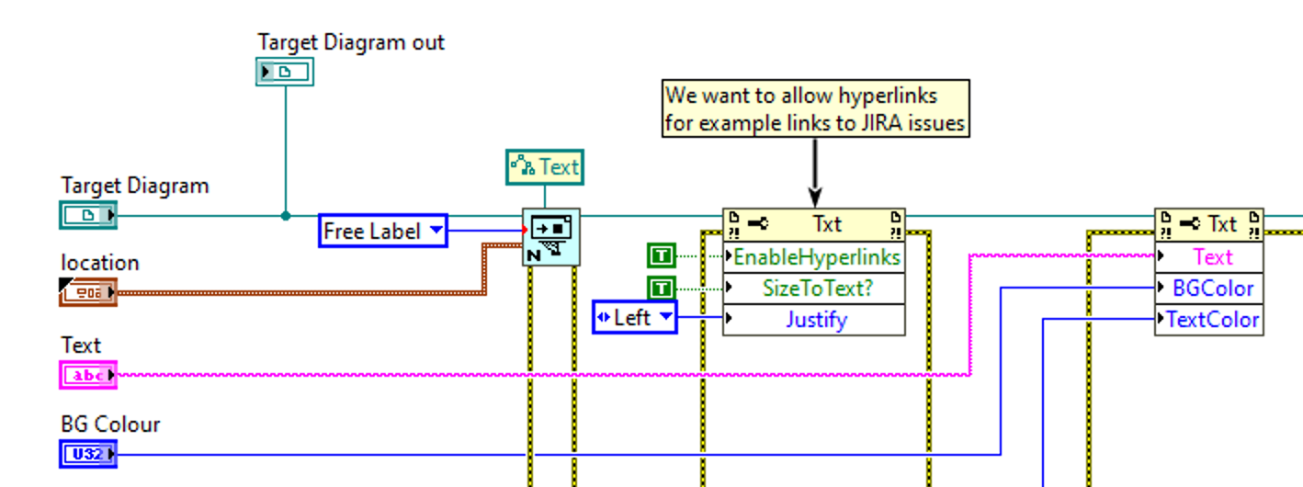
VI Scripting
Like VI Server
Deal with properties and methods
Operate on objects including
VIs
Controls, Indicators, Wires and other diagram objects
Project items
Modify, add and remove G code
Add new object

Slide 15
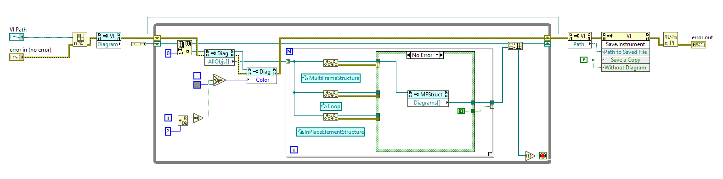
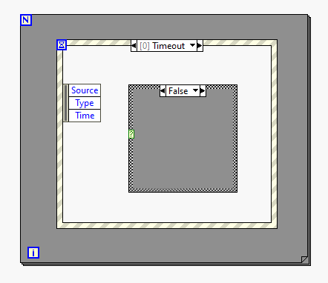
Example Scenario – Colour alternate structures

Slide 16
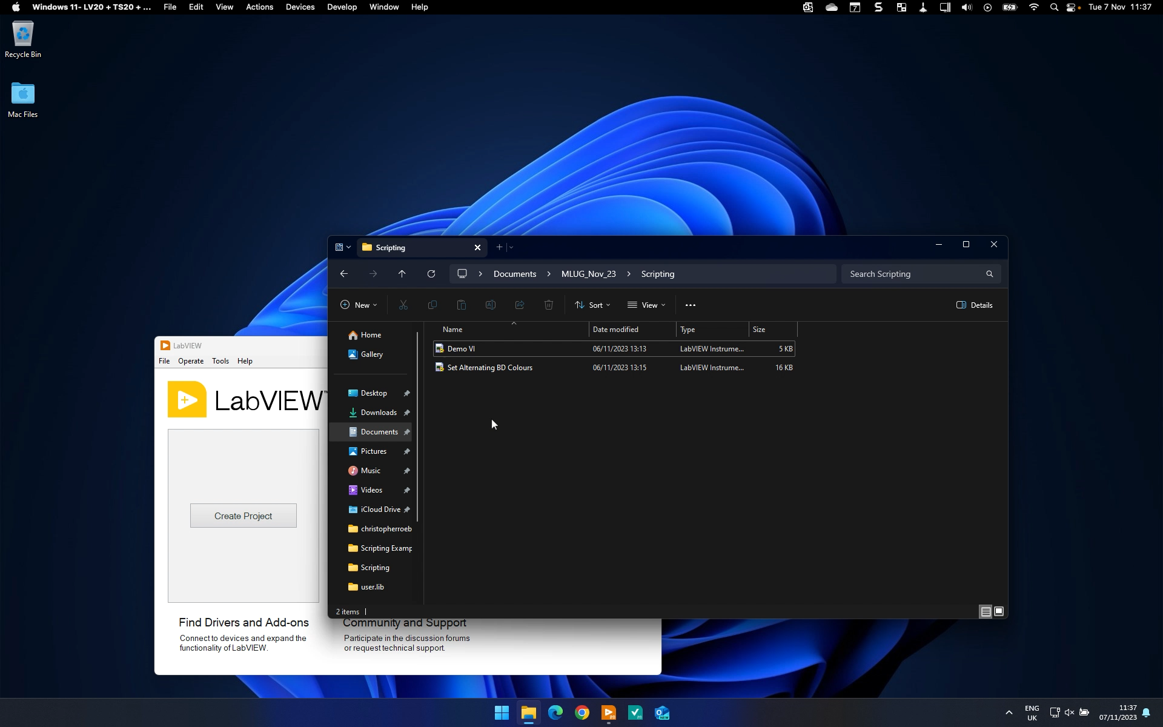

Slide 17
Quick Drop Shortcuts

Slide 18
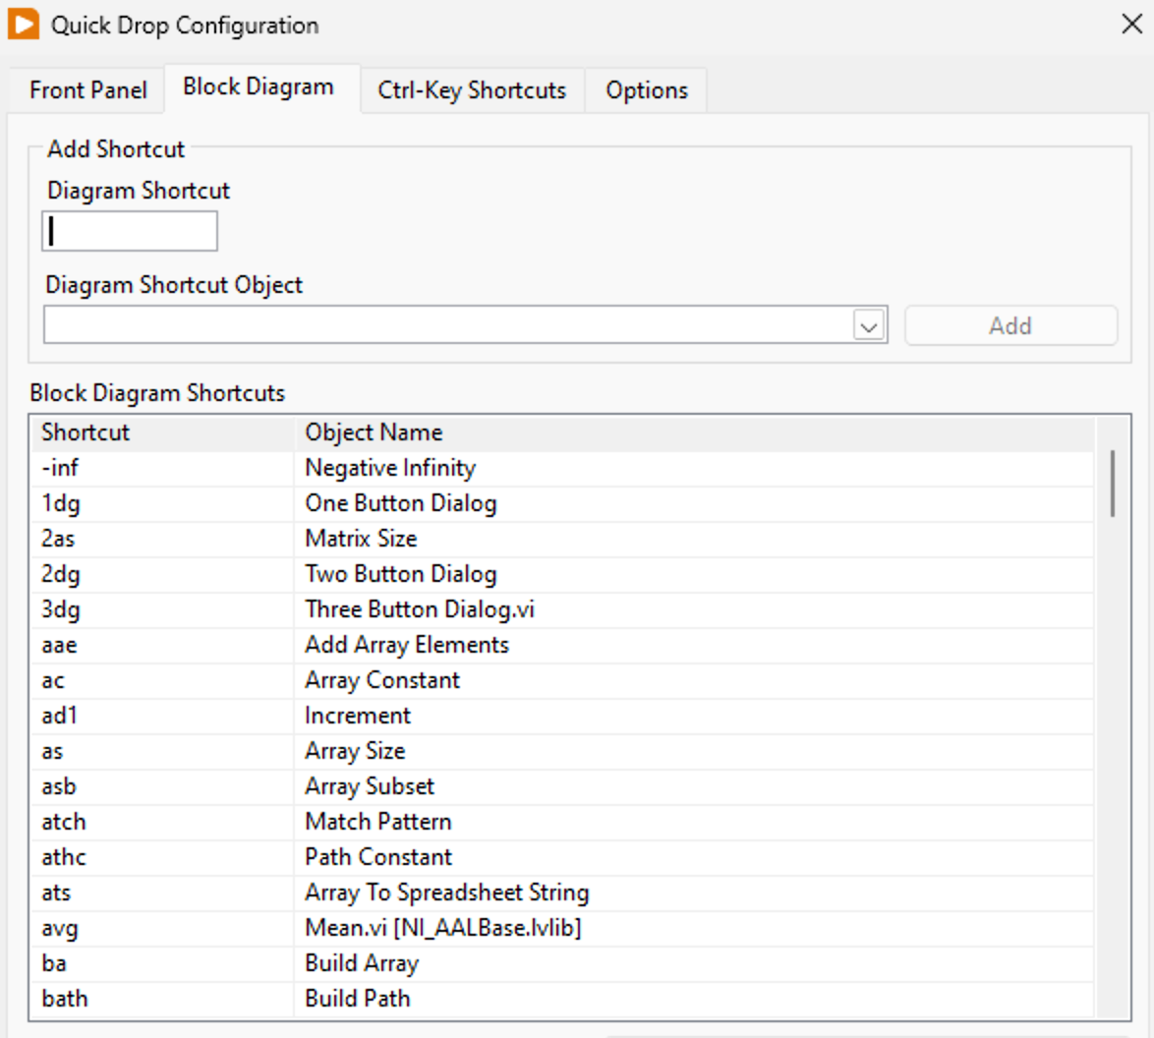
Quick Drop Shortcuts
Ctrl + key combinations used whilst Quick Drop is active
Launch Quick Drop with Ctrl + Space
Useful for frequent or repetitive editor tasks (Front panel or Block diagram)
Developer Guide exists
LabVIEW ships with 10 shortcuts but many more available on the NI community
www.ni.com/quickdrop

Slide 19
Quick Drop Shortcuts
Start with the template
[LabVIEW]\resource\dialog\QuickDrop\QuickDrop Plugin Template.vit
Put your plugin code (using the above template) into one of two locations
[LabVIEW]\resource\dialog\QuickDrop\plugins
[LabVIEW Data]\Quick Drop Plugins – Plugin available to all LabVIEW versions on the target machine

Slide 20
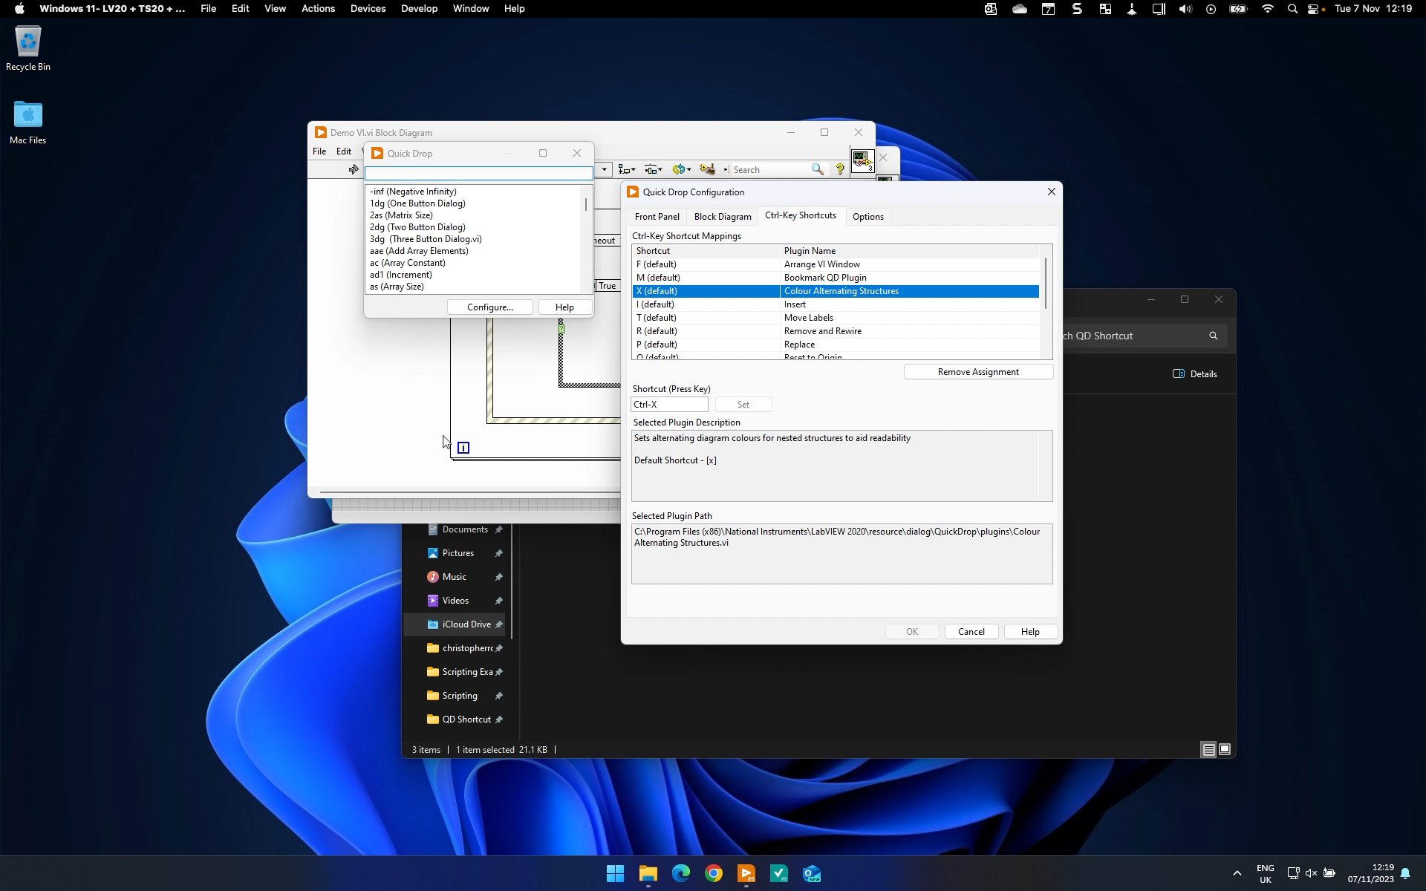

Slide 21
Tools Menu

Slide 22
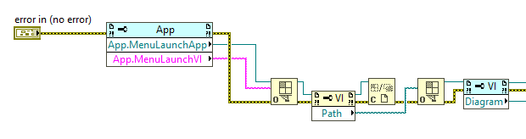
Tools Menu
Place your scripting code in [LabVIEW]\project
Requires scripting code to detect the VI which launched the tools menu to be able to obtain a reference to its diagram
Requires scripting VI to be set to Run When Opened
Folders can be used to create a menu hierarchy
Items can be hidden so as to not appear in menu by prefixing with _

Slide 23
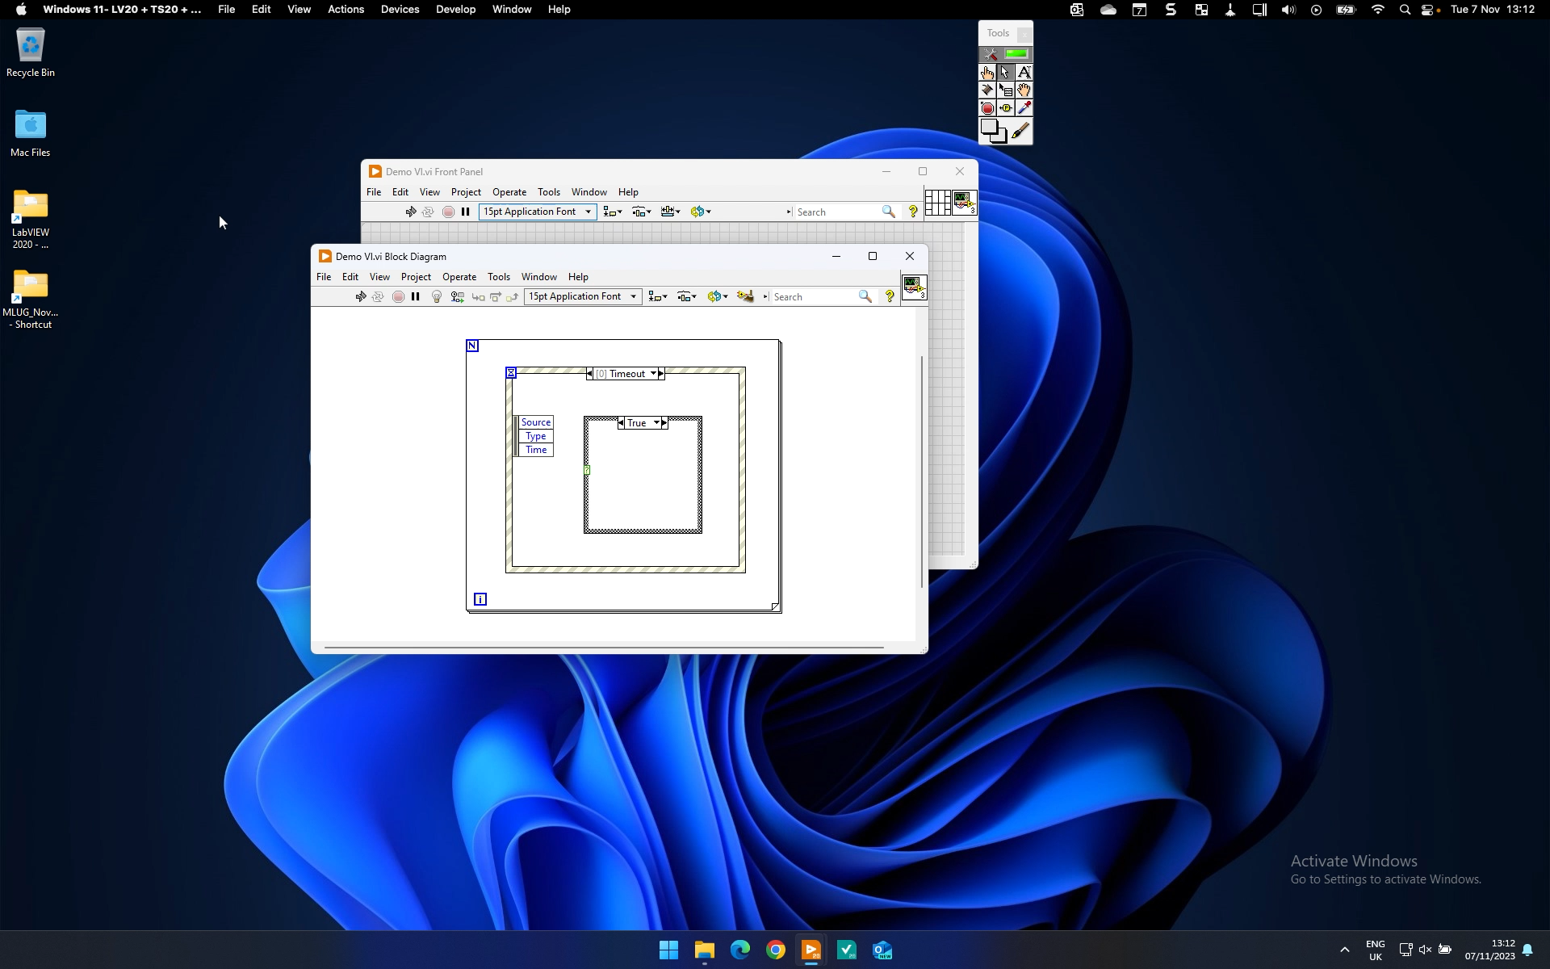

Slide 24
Right Click Plugins

Slide 25
New Project Templates

Slide 26
Project Provider

Slide 27

The LabVIEW Project Provider framework is an unsupported feature of LabVIEW. The only documentation for it exists in the NI community group, and it is community supported only. While NI has no plans to modify or break the existing APIs, there is no guarantee that all features will work in future versions of LabVIEW. Please use at your own risk. (2011).
The Project Provider is Scary…..

Slide 28

…but it’s also very cool

Slide 29
What is it?
The LabVIEW project window has a plug-in architecture to allow for easy extension of the project window features and capabilities.
A Project Provider is code that plugs into this framework to provide additional set of functionality to a project.
This functionality could be global - that applies to all items in the project or item-specific – that applies to specific item types

Slide 30
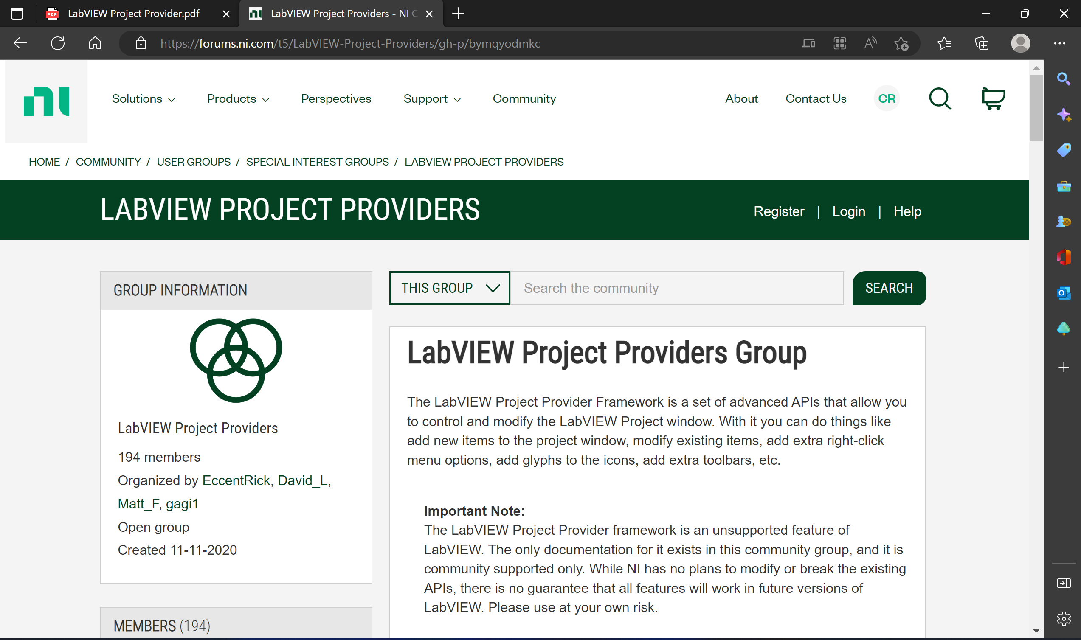
Where do I get it?
LabVIEW Project Providers - NI Community

Slide 31
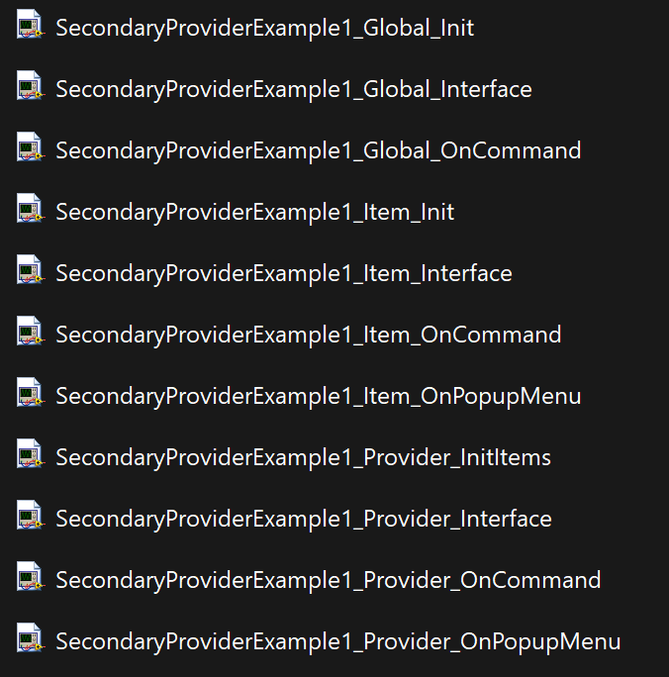
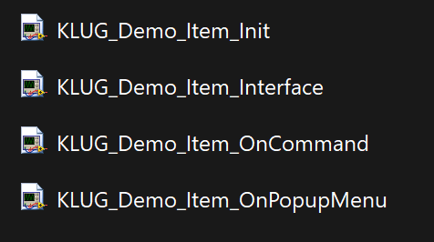
How do I use it?
Copy the example Project Provider VIs from the community page and rename the constituent parts (VIs) move it to <LabVIEW>\resource\Framework\Providers\<NAME>
Decide if the Provider apply to individual items or all (global)

Slide 32
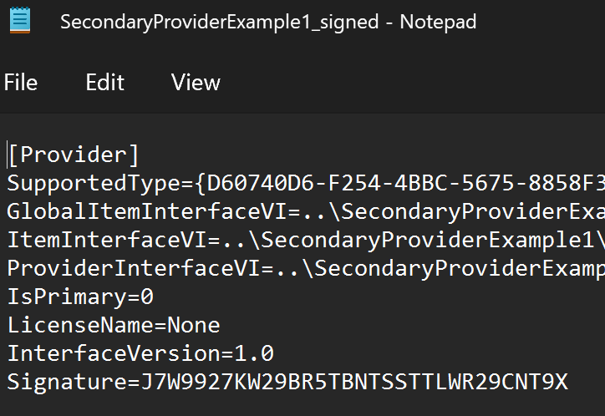
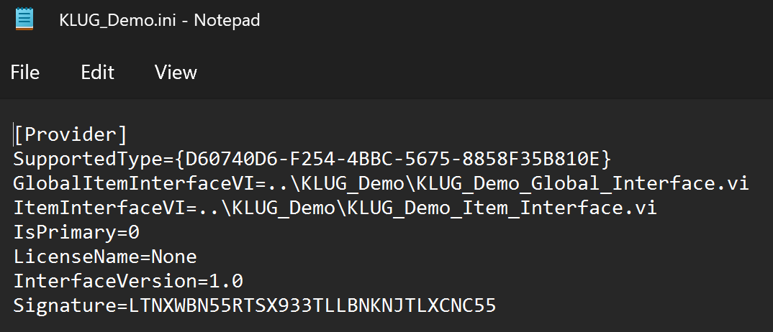
How do I use it?
Rename the ini file and move to <LabVIEW>\resource\Framework\Providers\Gproviders
Edit the ini file to reflect the providers required

Slide 33
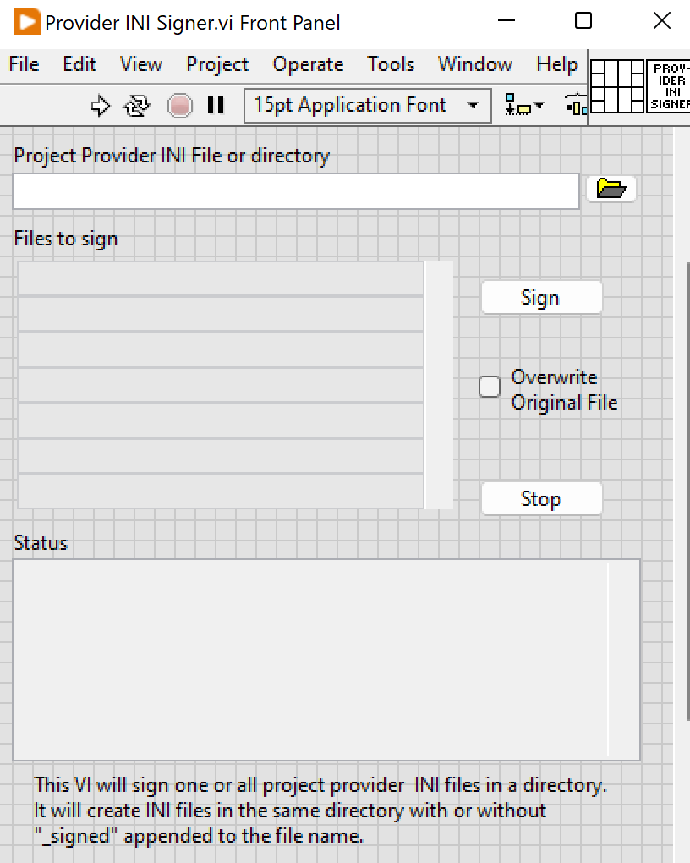
How do I use it?
Sign the Project Provider ini file using the ini file signing utility from NI
Get it from the community page

Slide 34
Edit the code (VIs)
Item_Interface.vi
Lists the other VIs (and their paths) in the Item provider
Item_Init.vi
Contains code to be executed as each item in the project window is loaded
Item_Popup.vi
Contained the code required to define the right click menu options for the item
Item_OnCommand.vi
Contains code to be executed when a right click menu item defined by this provider is selected

Slide 35
Demo

Slide 36
Multi-document Interface

Slide 37
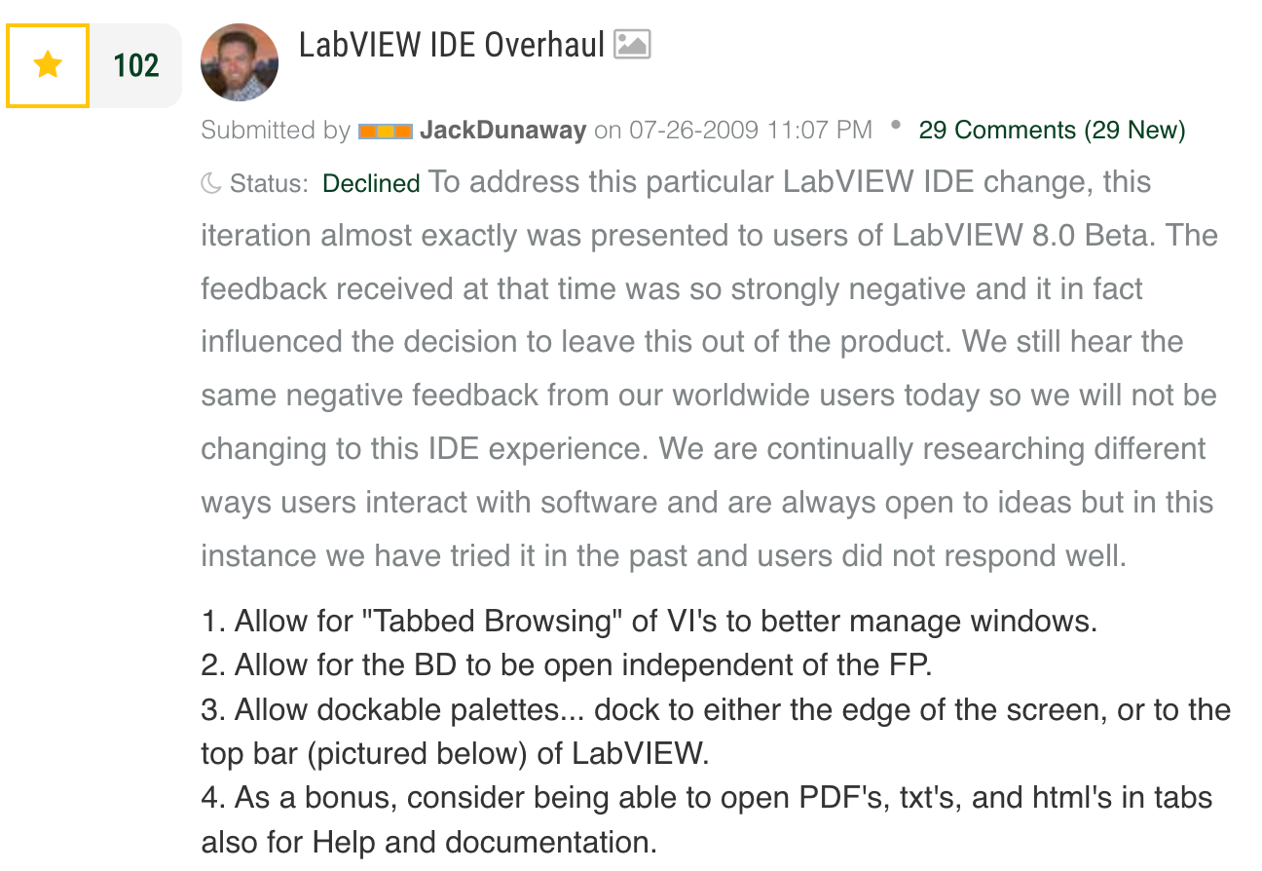
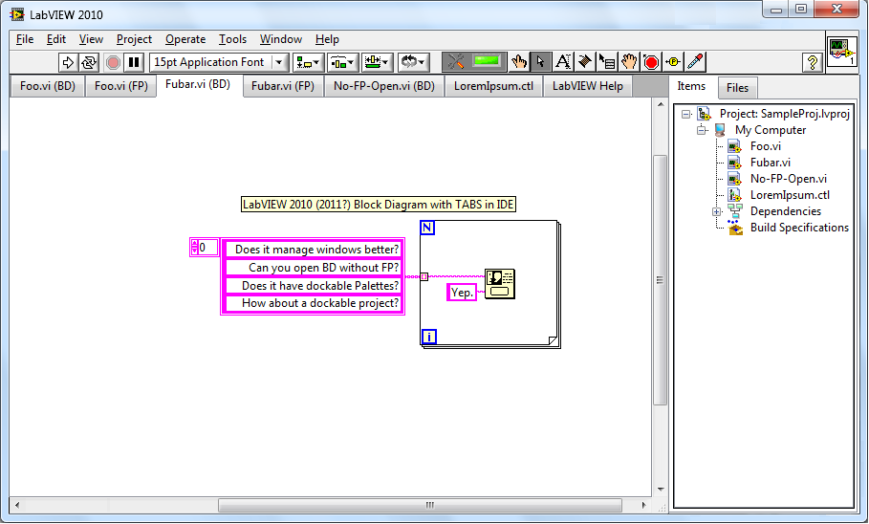
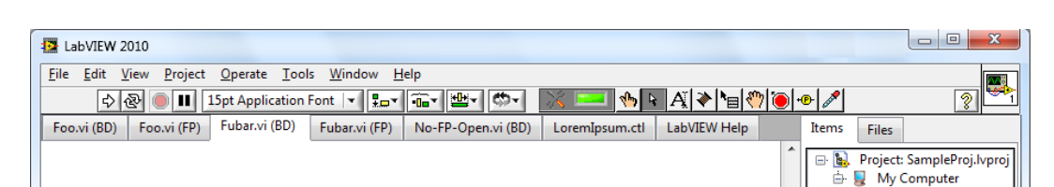
Tabbed IDE

Slide 38

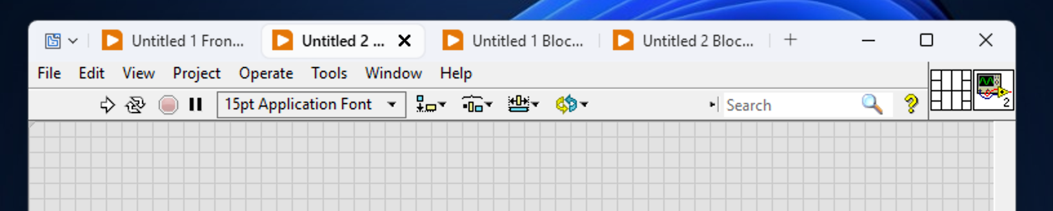
Try Groupy
$10.99 from StarDock

Slide 39
Want to play with the example code? https://bit.ly/462YWjM Want to use Bookmark Project Provider? https://www.ni.com/en/support/downloads/tools-network/download.bookmark-project-provider.html#374387

Slide 40

Keep in touch c.roebuck@konrad-technologies.co.uk https://www.linkedin.com/in/chrisroebuck/

